Slide 1
Lesson 3: Networking and Career Fair Prep
ENCP 6000
Career Management for Engineers
Fall 2019

Slide 2
Lesson 3 Learning Objectives
Discuss and explore the various ways to network
Understand the most effective way to network and how to execute it properly
Be Prepared for the Career Fair
Construct a plan to maximize your results at the Career Fair

Slide 3
What is Professional Networking?
Building and maintaining relationships of a business nature
Can take place online or offline in many situations or locations
Trusted communication that is mutually beneficial and may persist over time

Slide 4
Benefits of Networking?
Raises awareness about you
Learn how things work in other businesses or fields
Learn industry best practices and business trends
Builds strong relationships and rapport
Develops partnerships which can lead to referrals
Aids in becoming more influential in your industry

Slide 5
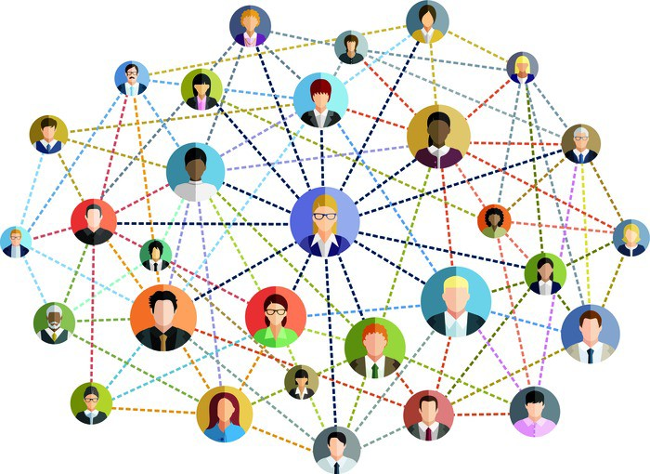
Networking Connections
Notes:
Examine you various ‘roles’ : Family, old friends, interest groups, current friends, colleagues, classmates, professors, etc….
How do you network with your pre-established network?

Slide 6
Building Your Network
Good networkers get jobs.
They are always on the look out for opportunities to meet and interact with people.
The more people you meet the better chances you have of finding the information you need that can lead to what you want.
Even if the person can’t help you, they may know someone who can.
Where?
- Networking Events (this is Boston, take advantage of it!!)
- Trade Shows/ Expos
- Online (obvious, but true!)

Slide 7


Maintain Your Network
There is no point in building up your network if you don’t use it or engage with it.
Introduce your connections to other people that may be valuable to them.
Make requests, but always follow up after that request is granted.
Notes:
This may be why you see that advisors don’t accept your LinkedIn request after you send it. If you have never met them, never tried to connect with them, why would they agree to it? At the minimum you should be sending a message with the request so they know your intention. And then following up after the connect has been made.

Slide 8
Networking Scavenger Hunt
Find a person who:
Owns shares in one business
Uses Facebook and LinkedIn everyday
Has the letter A in their first name
Requires glasses to read
Owns a patent for something they designed/created
Arrived to class today via public transportation
Has met a famous person
Had a coffee this morning from Dunkin Donuts
Notes:
Have the students breakout and start to try and find a person in the class that meets one of these criteria with the goal to find a person for every category.

Slide 9

Networking doesn’t have to be scary or hard. Some of the best Networking comes from being natural and the most true to yourself.

Slide 10
4 Steps for Networking Success
“It’s more important to be interested than to be interesting.” ​
– Christopher Barrat​
​
KNOW THEM/KNOW YOU​
LIKE THEM/LIKE YOU​
TRUST/CREDIBILITY​
BUY/SELL
Notes:
Successful Networking - the ultimate guide | Christopher Barrat | https://www.youtube.com/watch?v=NAWN8U3q7eQ
These are the steps to successful networking and learning them will help you immensely.​
​
KNOW: This is fundamentally what networking is all about, getting to know other people and letting them get to know you on a professional level.​
LIKE: As you get to know them, hopefully you will find yourself liking them and you are getting the feeling they are beginning to like you, too. ​
TRUST: This can only happen if they know you and they like you… they protect their networks by only referring those they find credible, trustworthy.​
BUY: You can’t ask for assistance until all three previous steps have been accomplished and in the order they are listed. You will be seen as more credible when offering help if you wait until this final step to offer help.​
​
Click to make green circle appear: The steps MUST be done in this order, knowing and liking first. If people get to know and begin to like you and you likewise them, the other two steps will flow naturally.​
​

Slide 11





How to Read a Room
Ones, twos and threes​
Open and closed groups​
Best choice: open group of three with at least one woman
Notes:
Read the slide and explain how people stand (1s, 2s, and 3+); types of groups (open or closed); and best choice.​
​
“As an introvert you might find yourself heading for the single, but don’t do it! With a single there will be the continuous need to converse! Instead, go for a group of three with at least one woman… this helps to keep you from:”​
​
being stuck in a conversation of one​
take the pressure off keeping the conversation going, your role in a three is to listen and ask questions​
maximizes your networking time​
If you used volunteers, thank them and then send them back to their seats.​
​
“Why one woman? There is research showing women typically do a better job of including others into groups.”

Slide 12

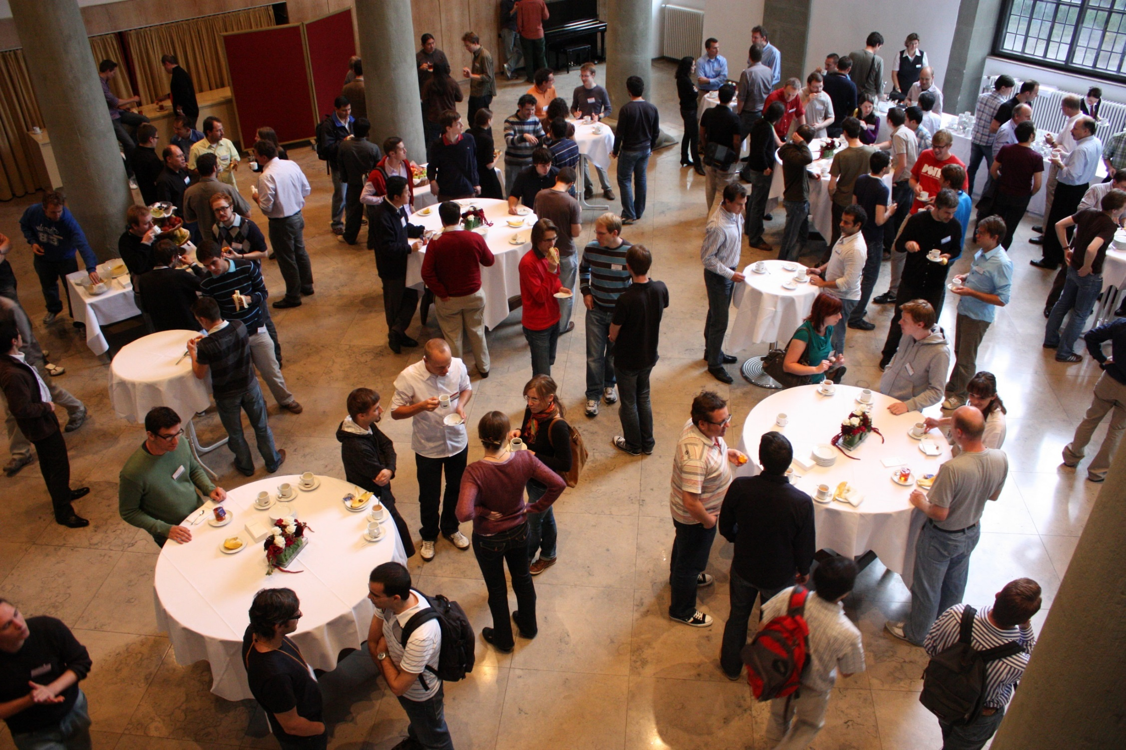





Notes:
So here is a typical networking event. There’s food and drink and folks are talking… let’s pick out who to talk to.
Give the students time to review the photo, maybe suggest a group and then click through…
Circled in red are singles and closed groups of two and four. – “We aren’t going to talk to these folks.”
Circled in orange is an open two. - “We aren’t going to talk with them unless we can’t find our best choice, which is?” Wait for response.
“Yes, an open group of three with at least one woman”
Circled in green is an open group three and it has one woman… “There’s are target, go!” So, what to do next?

Slide 13

How to Join a Group
“Hello. May I join you?”
Notes:
So you looked for and found an open three with a woman, you walk up and say… pause for a moment, maybe they will offer an answer…
“Hello. May I join you? It’s a simple as that. Unless they are extremely rude people, they will invite you in… now what?

Slide 14

How to Introduce Yourself
Five S’s of Introductions:
Stand if you are sitting
Smile
State your name
Shake their hand
Say “Nice to meet you.”

Slide 15
Conversation Flow & Tips
What do you do?
“I help job seekers prepare for and find great jobs”
“I’m transitioning into the field of career development and am looking for a great, new opportunity”
If you need to fill a sudden silence, try
“What are you hoping to get out this event?”
“Do you see any familiar faces?”
“What other networking events do you attend?”
If the person you are talking to seems well-connected…
“Would you mind introducing me to one of your contacts?”
If you find yourself suddenly with a single, or in a really boring conversation…
“It was very nice to meet you. Excuse me, I need to refill my drink.”
Notes:
Eventually, even in a group of three, you will need to talk so they members of the group can get to know you.
So being prepared with answers to some typical questions is helpful for you to keep calm and network!
When asked, “What do you do?” typically this is referring to your occupation, try to give a compelling answer.
Instead of “I’m Director of Operations at JobGoals” try “I help job seekers prepare for and find great jobs”
Instead of “I’m out of work and looking” try “I’m transitioning into the field of career development and am looking for a great, new opportunity”

Slide 16

Professional Appearance
Business Suit
Shirt / Tie
Shoes / Socks
Jewelry
Hair / Nails
Make-Up
Padfolio
Notes:
BE MINDFUL of your shoes- don't want to be walking like a duck or be the person who holds your heels (I've seen it happen).

Slide 17
Professional Appearance
Business Professional Attire
Black pants/skirt, neutral colors, no excessive patterns
Business Casual Attire
Dressy slacks, fashionable jacket & skirt, bright colors
Smart Attire
Clean jeans with a nice ironed shirt, soft fabrics
*Always dress one level higher than those you're meeting
*Location, event, and season will vary attire
Notes:
Point out how regions differ (California vs Boston)
Career Fair at Northeastern vs community Career Fair (Business Attire vs Business Casual)

Slide 18






Breath
Perfume/Cologne
Body Odor
Under dressed Over dressed Over Exposure

Slide 19


What Not to Do
When preparing for an event don’t:
Show up late or be improperly dressed
Forget to shower, brush teeth and use deodorant
Go heavy on the perfume, aftershave or alcohol
While at the Networking event don’t:
Interrupt a closed group or go straight for the sell
Stay with just one person the whole time
Start handing out business cards to everyone

Slide 20
Tips for Safer Social Networking
Use a strong, unique password (don’t use the same password on multiple sites; don’t use ID password on social networking sites)
Provide as little personal information as possible – avoid revealing birth date, address, etc.
Understand and customize the privacy settings in all of your social networking accounts
Don’t allow 3rd party applications to access your information (if possible)
Be careful about what you post
Photos of self or others
Opinions on controversial topics
Don’t rip classmates, professors, coworkers, employers, etc. – it WILL come back to haunt you
Don’t post anything related to your employer (unless you’re authorized)
Notes:
RockYou can stash 32 million passwords in the clear; when RapLeaf can index 600 million email accounts; and when Intelius can go public by buying 100 million profile pages; then our social networks have traded away our privacy for mere “privacy theater.” over the past few years — and negligently stored them in plaintext in an incompetently protected database.
RockYou’s official bluster about “illegal intrusion” should fool no one: blaming Imperva, the firm who exposed the flaw , or accusing the hacker(s) of being the identity thieves is misdirection: it was actually RockYou who stole those credentials, and RockYou should be held to account.
Read more: http://techcrunch.com/2009/12/27/privacy-theater/#ixzz0oaNyV1XL

Slide 21
Tips for Safer Social Networking Continued
Be suspicious of friend/follow requests, ads, 3rd party applications, chat messages, etc.
Use built-in and add-on features in web browsers to warn you of malicious sites
Anti-phishing filters in IE and Firefox
Web of Trust
NoScript
Adblock Plus
Preview features of bit.ly, TinyURL
Google yourself and scrutinize results
Think before you click!!

Slide 22

Final Thoughts
Be prepared to deliver anytime, anywhere.
Start with contacts that are safe to help build confidence.
Networking is not a quick fix to your next job; it should become a part of your work.
Be thoughtful about it and maintain it properly.

Slide 23

Questions?

Slide 24
Career Fair Overview
What Employers Expect
How to Prepare/Research
How to Present/Introduce Yourself
How to Follow Up

Slide 25
What to expect at a Career Fair
Networking opportunities
Learn about companies
Make connections
Make a lasting impression

Slide 26


Slide 27
What Employers Expect
Companies want to share information with students about their organization in a centralized format
Showcase roles and opportunities and provide more detailed information beyond their website
See who makes an impression!
Everything You Do Makes an Impact—Positive or Less Favorable.

Slide 28
How to Prepare: Research Employers
Know What the Employer Does
Primary Products and/or Services
Basic Industry Information including Competitors
Why the Organization and Department Interests You

Slide 29
Resources: Research Employers
Company Websites
Google
Glassdoor
LinkedIn
Social Media
Buzzfile
Notes:
Buzzfile can be accessed through the Resources section of NUcareers. It is a database of employers based upon region and industry with descriptions and various details.

Slide 30
Research Employers Who Hire International Students
Use the Career Fair Plus app (for NEU Boston’s Career Fair) to filter CPT/OPT
Identify if they are an A, B, or C employer
There will be no printed materials available at the Career Fair (NEU Boston)!
Notes:
Career Fair Plus app is a green circle with white font. Once downloaded, search for Northeastern University and selected the Graduate Career Fair (NOT UNDERGRADUATE).

Slide 31
Prepare: Your Plan
Make your A, B, C, target company list
If your A list is Google, Amazon and Facebook …
There is a lot of competition – what distinguishes you?
Long lines and wait times
Good to have ‘stretch goals’; being realistic is also good
Optimize your time & opportunity at the fair
Get there early if at all possible – lines will only grow longer
Target a “C” list company first to get your feet wet (get some experience)
Learn from that and approach your primary target companies
Start with your positioning statement and be able to say
I have read about your company and have interest in several areas including ...
Why the Organization and Department Interests You
Ask what types of opportunities might be available for your major
NO! Tell me about your company, I never heard of it before.
Notes:
Company Research:
Do your homework. Take the list of employers who will be there and research:
Company and employee social media accounts
YouTube videos
Recent press mentions
Product and service reviews
Company blog
Google search of the company.
Mergers or acquisitions
Company with whitepapers, case studies, presentations, keynote speeches
www.wefollow.com to search for company and employees on twitter- what topics are being talked about
Target clients for the company, competitors, challenges
www.finance.yahoo.com, www.corporatewatch.com; wikinvest.com for competitors
www.glassdoor.com for company culture
Research the Manager of the Department of Interest:
Social media sites
Google search
Management style?
What do former employees or co-workers say about him?
What accomplishments or projects does he seem to be most proud of?
More than one person has lost the job for posting an inappropriate comment on social media, even the year before they’re applying.
Google yourself—know what they see. Put Your LinkedIn profile on your resume. See if you know anyone at the company already or someone who knows someone and call them to chat if there’s time before the fair. Let them know you’re going to the career fair and are very interested in x position if you know them well.
Savor the chance to bypass computer screeners and bond with recruiters in person. To make your mark, you need to show some spark.

Slide 32
How to Handle Your International Student Status
Know your visa!
Northeastern sponsors you for internships and co-ops via CPT
It relates to your area of study
OPT (full-time) is different
STEM extension gives you 36 months of employment (no sponsorship)

Slide 33


What if they ask
Yes! I can be authorized to work in the US during co-op as part of my F-1 Student VISA or J-1 Visiting Scholar VISA.
Are you authorized to work in the US?

Slide 34
What if they ask
NO, but I have 12 months of work authorization after graduation and can get an additional 24 months (36 months total) if you are an E-Verify company as part of my F-1 VISA
Do you have authorization to work indefinitely for any employer in the U.S.?

Slide 35
What if they ask
Will you, now, or at any time in the future, need sponsorship from the employer for a work permit, visa or visa petition?
YES, however, I can work on co-op and will have 12 months of work authorization after graduation and can get an additional 24 months (36 months total) if you are an E-Verify company as part of my F-1 Student VISA without sponsorship

Slide 36

Speaking with Recruiters
Notes:
https://www.youtube.com/watch?v=VyJ-ksaAsFo
Alternative video: https://www.youtube.com/watch?v=Iq1M5RH0vIk

Slide 37
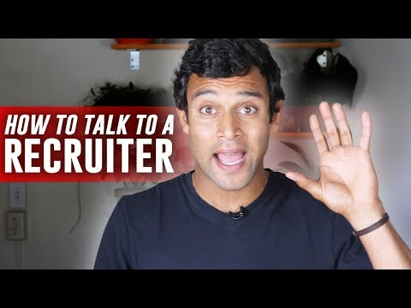

Slide 38

Practice Your Positioning Statement
Find a partner
Shake their hand
Deliver your statement to each other
What did your partner do well? What could your
partner improve on?
Remember to practice your statement with your peers – and be sure to speak in a clear and moderate pace.
It should not be longer than 60 seconds

Slide 39
The Conversation
Ask companies and organizations which skills and key words you should be using
Ask the companies you talk to for guidance on how to best be proactive so that it culminates in an interview.
Get a sense of their timeline for the process.
Ask if your background looks like it might be a fit for the position.
Ask about other positions in the pipeline if they know that info
What you could do now to stand out more if you’re not yet a senior and applying for a specific position.

Slide 40
Tips
Get information about next steps and how they suggest you follow-up.
We understand this is a new experience; be prepared for the pace- transactional, fast-paced!
Remember to show them your research in your pitch.
No food, no coffee/drinks
Utilize the student break room for your coats and umbrellas
NO backpacks allowed
Employers offer free gifts - SWAG
You can take one but only one … professional behavior at all times
Walk around alone, not with a friend.
Notes:
- you can’t really shake hands, talk and connect if you’re drinking and eating
This is business.

Slide 41
Follow Up & Follow Through!
After the Fair:
Within 24 hours, write a thank you note (email)
Did you follow through on employers’ suggestions?
This is an opportunity to add, enrich, reinforce your interest and qualifications!

Slide 42
Tips for 1st Semester Students
Familiarize yourself with companies who attend
Review job descriptions to create goals matching the skills they seek
Boost your confidence by crafting stories on projects and experiences you've done

Slide 43

Questions?

Slide 44

Assignments
Get Informed Module must be completed before Lesson 4

